Slide 1
Foundations for Training Theories and Principles
There are 3 key principles that will be studied in this module. They are:
1. The F.I.T.T. Principle
2. The Overload Theory
3. The Specificity Principle

Slide 2

F.I.T.T. PRINCIPLE

Slide 3
Learning Targets
Students will be able to…
Define and describe the FITT Principle
Apply the FITT Principle to the Components of Fitness
Describe two methods of measuring intensity
Calculate MHR and THR
Identify intensity levels appropriate for Heart Health

Slide 4




What is the F.I.T.T. Principle?
A formula in which each letter
represents a variable important for
determining the correct amount of
physical activity to reach fitness goals.

Slide 5
FITT Principle Formula:
4 Variables
Frequency
Intensity
Time
Type
The values for each one change based on which Component of Fitness or activity they apply to

Slide 6
Variables Differ Based on Component of Fitness
VS
Muscular Endurance
Cardiorespiratory Endurance
Recommended Frequency
F = 5-7 sessions/week
Recommended Frequency
F = 2-3 sessions/week

Slide 7


Frequency
Frequency refers
to how often an
activity is
performed each
week.

Slide 8

FREQUENCY= sessions/week
FITT
Dan goes to Harbor Square three days a
week for an hour each day to lift weights.
What is Dan’s frequency
for resistance training?
DAYS/WEEK

Slide 9

Intensity
Intensity refers to
how hard an
activity is
performed each
session.

Slide 10

Intensity = Effort
0%
100%
What level of intensity would you run during the 100 meter dash?
Would you run at the same intensity for the mile run?

Slide 11
How do you increase intensity?
Increase speed or pace (i.e. run faster!)
Add more resistance during weight training
Hold a push-up ½ way
Bicycling in a lower gear
Running/cycling up hills
Increase reach of stretch
Can you think of additional examples?

Slide 12

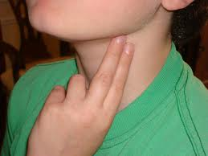
How do we measure how hard you are working?
1. Check your heart rate (pulse)
2. Use a RPE scale (1-5) based on your opinion of how hard you are working

Slide 13
Intensity: Variable Example
Muscular Strength
Muscular Endurance
Recommendation for F & I
F= 2-3 sessions/week
I = Heavy resistance
Recommendation for F & I
F= 2-3 sessions/week
I= Light resistance

Slide 14

TIME
Refers to how
long an activity
is performed at
each session.

Slide 15
Time Includes:
4 Stages of exercise
Warm-up (increase HR & blood flow)
Stretch (dynamic flexibility)
Activity
Cool-down (includes static stretching)
Which stage should last the longest?

Slide 16
Identifying Variable: Time
Cardiorespiratory Endurance
Muscular Strength
Recommendation for T =
60+ min.
Recommendation for T =
# of repetitions: 4-8

Slide 17

TYPE
Type refers to
which
activities are
chosen.

Slide 18
Examples for Types of exercises
Weight Training
Biking
Running
Swimming
Calisthenics
Static Stretching
Dynamic stretching
Martial arts
Yoga
Plyometrics
Pilates

Slide 19
Identify the F.I.T.T Variables
Jane is starting to train for the Seattle to Portland bike ride. She rides her bike 5 times a week. Each ride is 2 hours long. Jane uses a heart rate monitor to measure her intensity as she rides. Her goal is to be in her Heart Health Zone during her ride (65%-85% MHR or level 4 RPE).
Frequency =
Intensity =
Time =
Type =
5 times a week
65%-85% of MHR or Level 4 RPE
2 hours each ride
biking

Slide 20
BACK

Slide 21
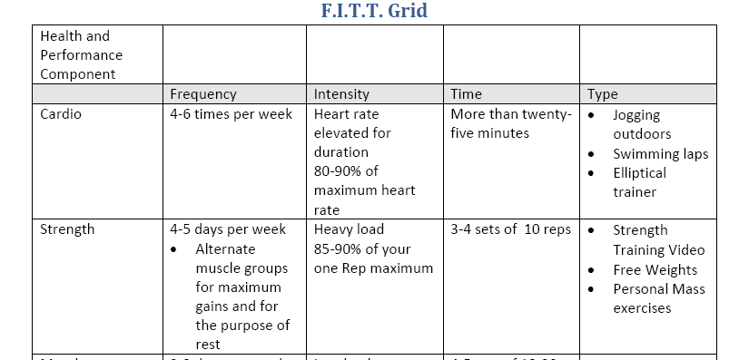
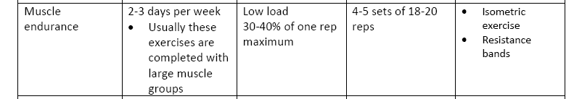
The F.I.T.T Grid

Slide 22
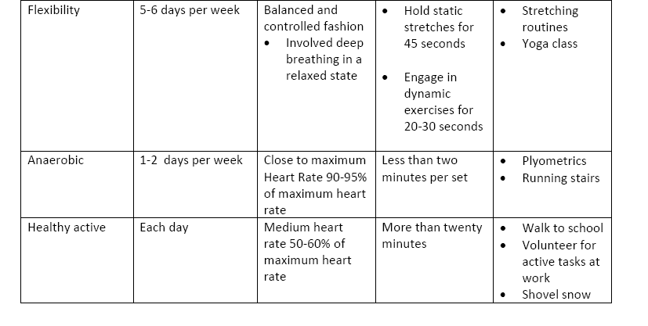
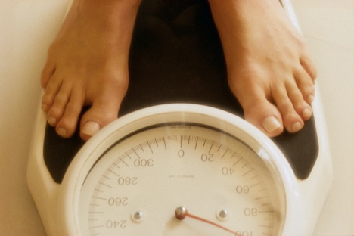
The F.I.T.T Grid - continued

Slide 23


Overload Theory
As mentioned previously, there are many theories that are related to specific goals in training. The Overload Theory is one of many theories that contribute to training. This theory focuses on the idea that in order to gain results, muscles must do more effort than previous situations in order to obtain gains in muscle mass. The Overload theory essentially states that in order for muscles to develop they must be challenged and taxed.
The four components of the F.I.T.T. theory assist us in challenging and taxing the muscles for a period of time in order to achieve gains in muscular strength and mass. Usually when people focus a training program based on the F.I.T.T. principle they will see gains based on the Overload Theory due to the fact that when they commit to a training schedule they increase the amount of use of their muscles and body systems.

Slide 24

Specificity Principle
When we focus our training on goals that we set we are often aware of specific areas that we would like to target. You may be looking to target a system in your bodies or a muscle group. When we participate in training focusing on specific muscle memory tasks we are using the Specificity Principle to train.
Athletes use this to gain more strength in the muscles that are specific to their performance needs for their particular sports. They may participate in certain exercises in a repetitive motion or many exercises focusing on one area. People who are training for active living purposes may focus on a specific area for health or medical reasons or for improvement in perception of body type.

Slide 25

Health Components
Cardiovascular Health: your performance is based on the amount of oxygen that is available to your muscles for continued production of energy.
Muscular Strength: the amount of force a muscle group or an isolated muscle can produce against an opposing force.
Muscular Endurance: when given resistance a muscle is able to sustain the force for a long period of time.
Flexibility: the ability for any joint to move through its full range of motion.

Slide 26
Performance Components
Power: is the combination of speed and strength. Power relates the ability of contracting a muscle for short explosive bursts of energy
Agility: is the ability to move in numerous directions with power and coordination.
Speed: is the ability to move at a quick pace.
Coordination: is the ability to integrate movement, balance, and skills to be successful in fine motor skill activities.
Balance: is the ability to maintain a still state in a controlled fashion.

