Slide 1
The French revolution
Social 20 – 2015
Updated – 2016
Kyle McIntosh – kmcintosh@brsd.ab.ca

Slide 2
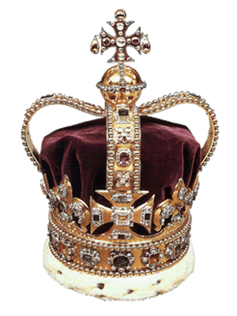
To what extent should we embrace nationalism? RI #1: To what extent should nation be the foundation of identity?
Social factors
Pre-revolutionary France had a very unfair social structure.
The Monarchy (the king/queen and their family) as well as the Clergy (the church members) were heavily favored.

Slide 3
A handful of terms…
Feudalism: Was the most prevalent form of government in medieval Europe. A King/Queen was at the top of the social/power hierarchy. The monarch would grant power and land to his/her nobles who would then in turn do so for those below them on the social hierarchy. At the very bottom were peasants who had no or little political rights. Feudalism looked somewhat differently from country to country.

Slide 4
Absolute Monarchy: Exemplified by French King Louis XIV (14th) A newer and more powerful form of monarchy where the King/Queen was in absolute control of all aspects of the government. In the old form the King relied on support of his nobility, but in absolutism he did not have to, he had it.

Slide 5
Divine Right of Kings: The belief that God has appointed the monarch as the king and therefore he receives his authority directly from God, and answers only to God. – in a highly religious country like France this would ensure the power of the monarchy.

Slide 6
To what extent should we embrace nationalism? RI #1: To what extent should nation be the foundation of identity?
96% of the French population were ‘commoners’, who were taken advantage of by the ruling classes.

Slide 7
The middle class of France (known as the bourgeoisie) was growing, however.
The bourgeoisie were educated & hard-working, and had a lot of strong ideas about individual rights.
They spread discontent through the French population.

Slide 8
The Three Estates
Estate | Population | Privileges | Exemptions | Burdens
First | Circa 130,000 High-ranking clergy | Collected the tithe Censorship of the press Control of education Kept records of births, deaths, marriages, etc. Catholic faith held honored position of being the state religion (practiced by monarch and nobility) Owned 20% of the land | Paid no taxes Subject to Church law rather than civil law | Moral obligation (rather than legal obligation) to assist the poor and needy Support the monarchy and Old Regime
Second | Circa 110,000 Nobles | Collected taxes in the form of feudal dues Monopolized military and state appointments Owned 20% of the land | Paid no taxes | Support the monarchy and Old Regime
Third | Circa 25,000,000 Everyone else: artisans, bourgeoisie, city workers, merchants, peasants, etc., along with many parish priests | None | None | Paid all taxes Tithe (Church tax) Octrot (tax on goods brought into cities) Corvée (forced road work) Capitation (poll tax) Vingtiéme (income tax) Gabelle (salt tax) Taille (land tax) Feudal dues for use of local manor’s winepress, oven, etc.

Slide 9
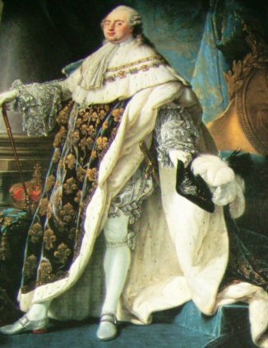
Our first main character - Louis XVI
Was 20 years old when he came to the throne
By this time the Estates were displeased with the absolute rule of kings their centralized government, wealth, and indifference.
Marie Antoinette was vilified by the masses, though she had little to do with the problems people were facing.
Both Louis and Marie had distanced themselves from the problems of the state.

Slide 10
What the King Did
Appointed the Intendants, the “petty tyrants” who governed France’s 30 districts
Made decisions regarding war and peace
Made all laws
Could imprison anyone at any time for any reason (blank warrants of arrest were called lettres de cachet)
Controlled justice by appointing judges
Controlled the military
Levied all taxes and decided how to spend the money
Appointed the people who would collect his taxes and carry out his laws

Slide 11
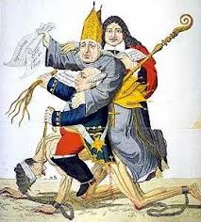
King Louis XVI
Noble
‘Commoner’
Clergy

Slide 12
Taxes In France
Name | Tax | Who Paid | Exemptions
Taille | Land/ income tax | Everyone – except soldiers | Nobles/ Clergy
Capitation | Poll tax | All people | Nobody – but nobles and clergy evaded it
Twentieths | 20th of years earnings | All people | Nobody – but nobles and clergy evaded it
Corvee | Mending roads | All able men | Clergy, shepherds, nobles, townspeople, teachers
Gabelle | Salt tax | Anybody buying salt | Some provinces were exempt

Slide 13
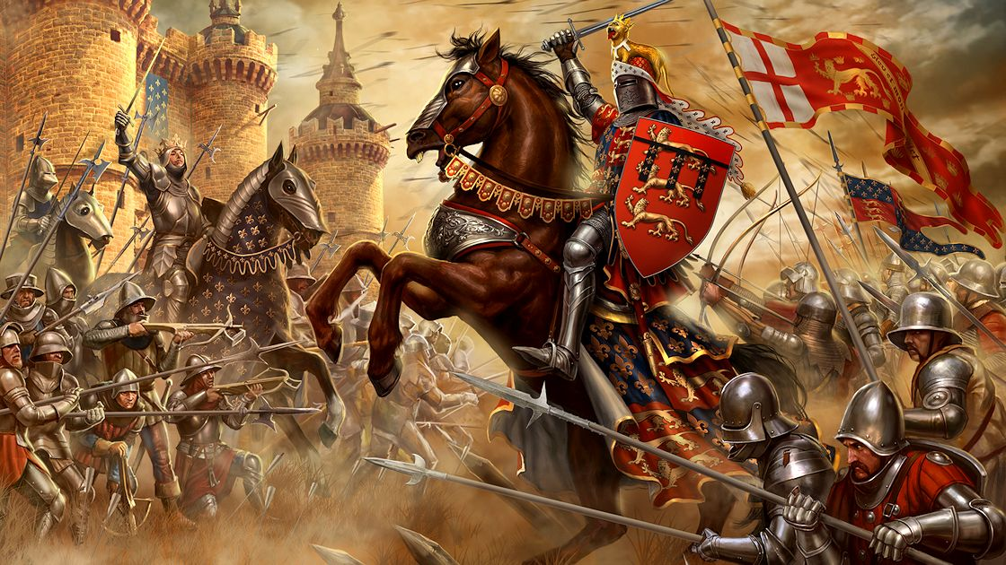
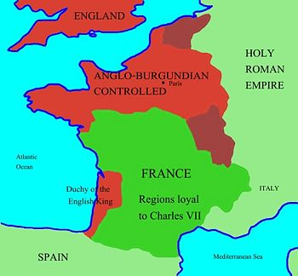
Economic factors
France and Britain had never really gotten along, and they certainly weren’t in the 1700’s.
They were at war almost constantly for 100 years.

Slide 14
To what extent should we embrace nationalism? RI #1: To what extent should nation be the foundation of identity?
War is expensive, and after all this constant fighting, France was super poor.
=

Slide 15
A History of Violence – The American Revolution
Colonists in North America want the same rights as citizens living in Britain
Control of the economy (taxation without representation)
Boston Tea Party
Because Britain was so far away, the colonists were used to ruling themselves
Enlightenment ideas had spread here

Slide 16
The American Revolution
In 1776 the colonists write the Declaration of Independence, saying King George III needed to be overthrown (bit crazy)
The resulting bloody war lasted 8 years, with France providing both financial and military support to the colonists (which creates some of the financial problems that leads to their revolution) ((Also…French citizens were acutely aware that revolution exists!!!)
When the war ended, the new nation-state used the ideas of the Enlightenment philosophers to create their new government
Many nations around the world, including France and Canada, have used those ideas to create their government structures.

Slide 17
Philosophy of the French Revolution: The Enlightenment (Age of Reason)
Scientists during the Renaissance had discovered laws that govern the natural world
Intellectuals – philosophes – began to ask if natural laws might also apply to human beings
Particularly to human institutions such as governments
Philosophes were secular in thinking – they used reason and logic, rather than faith, religion, and superstition, to answer important questions
Used reason and logic to determine how governments are formed
Tried to figure out what logical, rational principles work to tie people to their governments
Questioned the divine right of kings

Slide 18
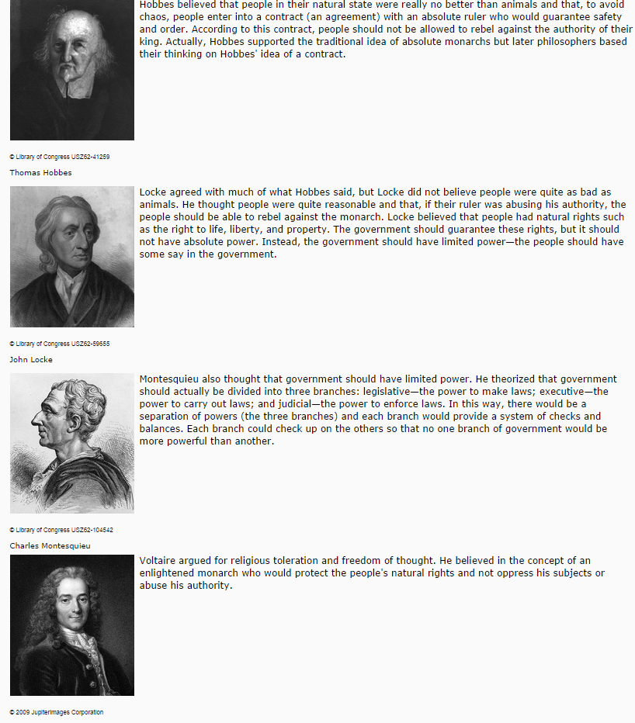

Slide 19
Economic Conditions under the Old Regime
France’s economy was based primarily on agriculture
Peasant farmers of France bore the burden of taxation
Poor harvests meant that peasants had trouble paying their regular taxes
Certainly could not afford to have their taxes raised
Bourgeoisie often managed to gather wealth
But were upset that they paid taxes while nobles did not

Slide 20
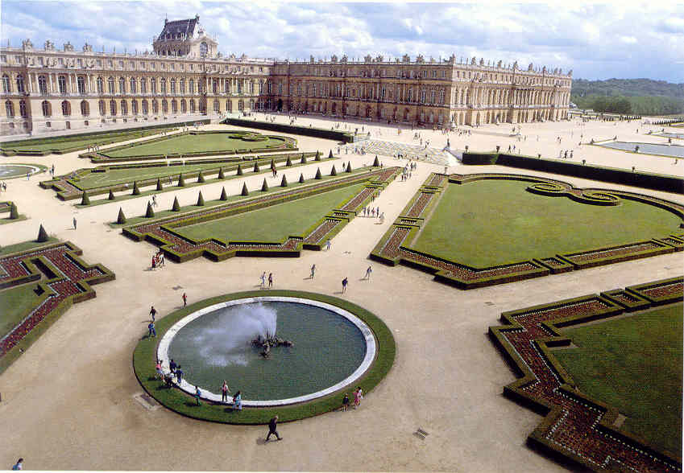
Louis’ Actions
First:
Louis took every opportunity to show the people the greatness of the monarchy. He built the great palace of Versailles. He crafted his image of the ‘Sun King’ though the use of propaganda.

Slide 21
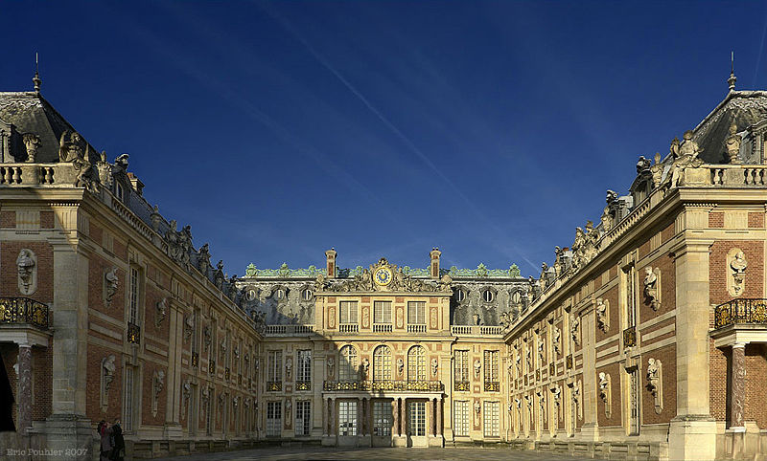
The Palace of Versailles

Slide 22
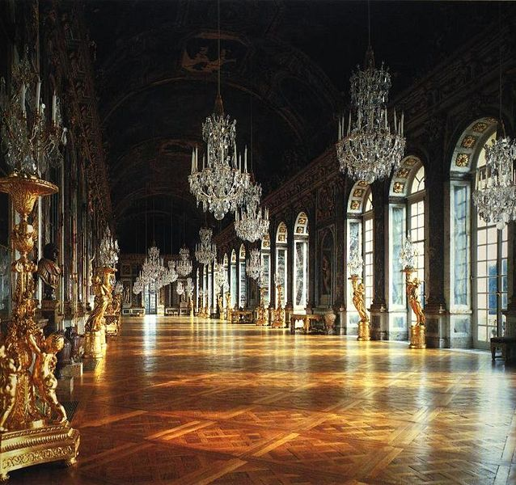
The Hall of Mirrors

Slide 23
Second:
Louis made sure that the nobility and significant groups in France were benefited by the growth of royal power. He often met with regional parliaments when his new policies would affect them. He tried to remove reasons people would attempt another revolt like the Fronde.
Third:
Louis held extravagant parties in order to lure the nobles into his company. Nobles would wait on him in the morning, watch him eating his meals, confer with the king in meetings. To be close to the king was a way to improve one’s position in France…

Slide 24
To what extent should we embrace nationalism? RI #1: To what extent should nation be the foundation of identity?
ASIDE: Geographic factors
Just as Louis XVI was calling together the Estates General to try forcing taxes on his people, large parts of France were suffering from terrible weather.

Slide 25
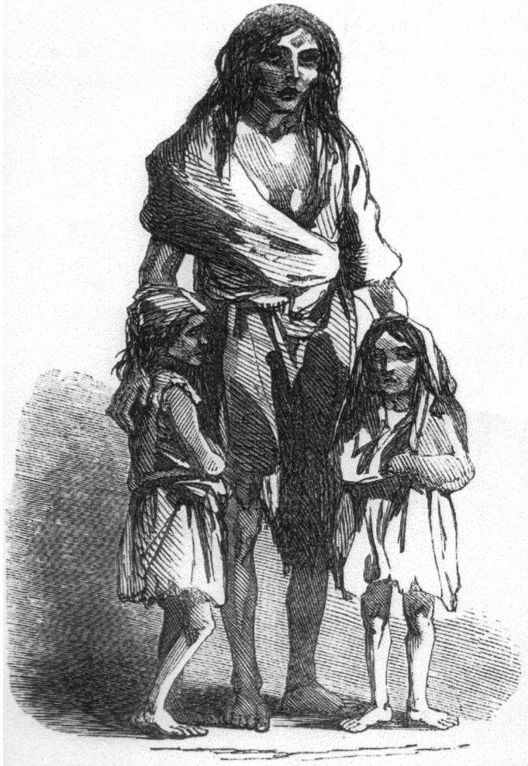
The weather killed crops, and a huge food shortage ensued.
People began rioting and stealing food.
Discontent was widespread.

Slide 26
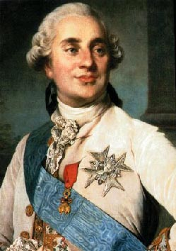
To what extent should we embrace nationalism? RI #1: To what extent should nation be the foundation of identity?
To get money for more wars, and despite the famine, the man who was king of France before the revolution (Louis XVI; the 16th) wanted to institute more taxes.

Slide 27
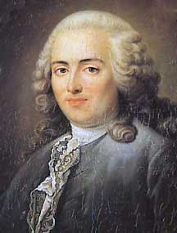
What made Louis XVI fail?
Louis’ chief financial advisor, Anne Robert Jacques Turgot (1727-1781), devised a way to escape the financial problems that surrounded France. Thought there was much money in the country it was in the hands of the nobility and could not be touched.
Turgot sought to control tax farmers, abolished the guilds, and planned to replace the corvee with a tax (on property) on all three Estates.
The church and the nobility opposed these measures.
1775 the Flour War erupted with harvest failures and bread shortages. The People of France could not afford bread and peasants and urban workers took to the streets demanding price controls.
Turgot was blamed and dismissed.

Slide 28
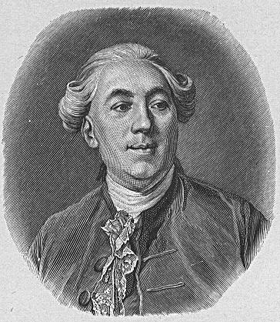
What made Louis XVI fail?
Jacques Necker (1732-1804) took over as financial advisor, and borrowed money for France’s part in the American Revolution.
An Enlightened thinker.
This plunged France into greater debt. 50% of France’s yearly revenue went to pay to service their debt.
Necker published the royal budget and the king was outraged
He tried encourage the king to give the Third Estate a greater number of seats.
Necker encourages the king to call the Estates General.

Slide 29
To what extent should we embrace nationalism? RI #1: To what extent should nation be the foundation of identity?
A lot of the rich people that Louis XVI wanted to tax didn’t like the idea, and they tried to stop him.
To stop Louis XVI, the nobles forced him to call together the Estates General, which was essentially French parliament.
It hadn’t been called together for almost 200 years.
(Economic, Social)

Slide 30
Short-term Causes of the French Revolution
Bankruptcy
Caused by deficit spending
Financial ministers (Turgot, Necker, Calonne) proposed changes
Great Fear
Worst famine in memory
Estates-General
Louis XVI had no choice but to call for a meeting of the Estates-General to find a solution to the bankruptcy problem
Had not met since 1614
But these were rejected
Assembly of Notables voted down taxation for the nobility in 1787
Hungry, impoverished peasants feared that nobles at Estates-General were seeking greater privileges
Attacks on nobles occurred throughout the country in 1789
All three estates
Set in motion a series of events which resulted in the abolition of the monarchy and a completely new socio-political system for France

Slide 31
Preparing for the Estates-General
Winter of 1788-1789
Members of the estates elected representatives
Cahiers
Traditional lists of grievances written by the people
Nothing out of the ordinary
Asked for only moderate changes
You will read about these in your Document Based Analysis

Slide 32
Calling The Estates General
1. By the spring of 1789, the French government faced the imminent threat of bankruptcy. (Economic)
2. The refusal of the Assembly of Notables to support Louis XVI’s program of tax reform forced the king to call a meeting of the Estates General.

Slide 33
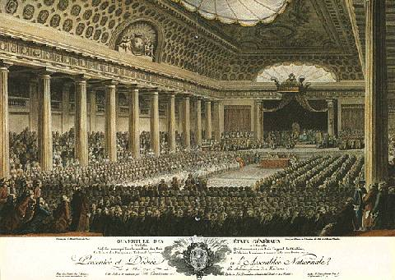

Slide 34
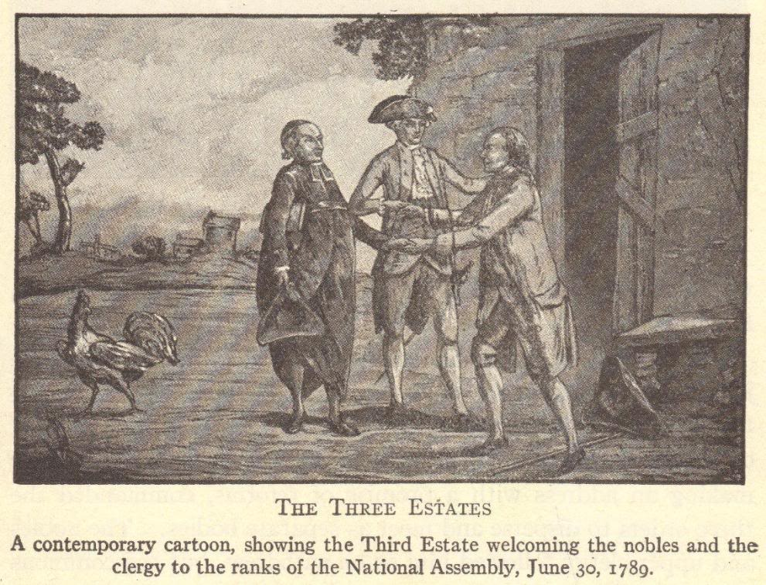

Slide 35
To what extent should we embrace nationalism? RI #1: To what extent should nation be the foundation of identity?
The Estates General had representatives from 3 separate social groups (known as estates):
The First Estate: Clergy (church leaders)
The Second Estate: Nobility (rich people)
The Third Estate: Everyone else (the common people)

Slide 36
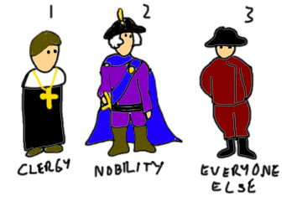
To what extent should we embrace nationalism? RI #1: To what extent should nation be the foundation of identity?

Slide 37
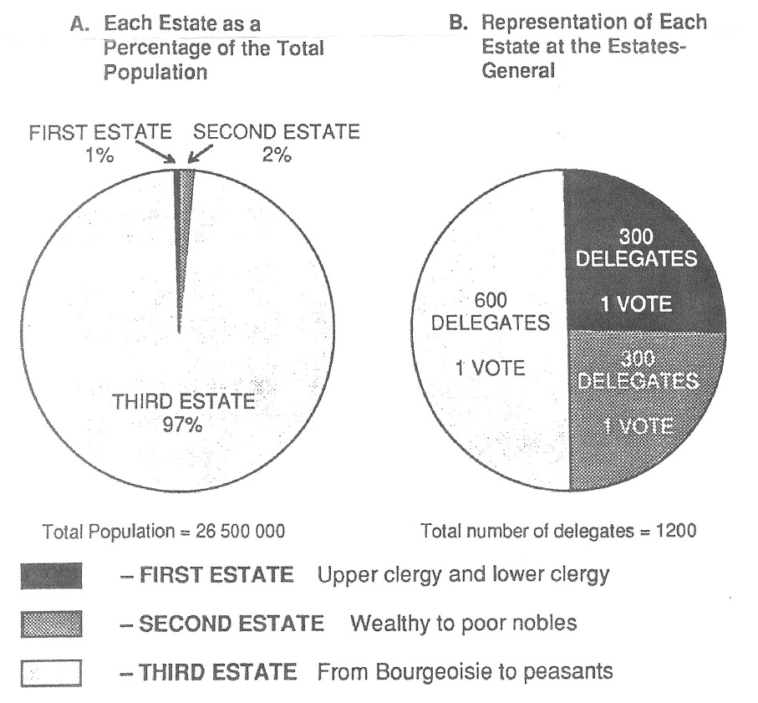

Slide 38
To what extent should we embrace nationalism? RI #1: To what extent should nation be the foundation of identity?
Louis XVI thought that he had the vote in the bag…
But the Third Estate (the common people) decided that, rather than getting beaten by unfair voting regulations*, they would find a work-around.
*Even though they were by far the largest estate, they didn’t get the largest vote…

Slide 39
C. The Tennis Court Oath, June 1789
1. Members of the first and second estates assumed that each estate would receive one vote. This system would enable them to impose their will on the third estate.
2. Led by Abbe Sieyes, the third estate rejected this method of voting and demanded that all three estates meet together.
3. When the king refused, the third estate declared itself the true National Assembly of France.

Slide 40
Locked out of their official meeting place, the third estate met in a nearby indoor tennis court where they took an oath not to disband until they drafted a written constitution.
4. The Tennis Court Oath marked the beginning of the French Revolution.

Slide 41
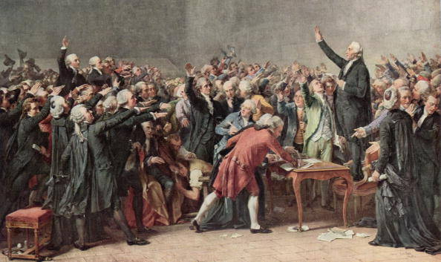
Tennis Court Oath sworn by the National Assembly (third estate)

Slide 42
The Tennis Court Oath
“The National Assembly, considering that it has been summoned to establish the constitution of the kingdom, to effect the regeneration of the public order, and to maintain the true principles of monarchy; that nothing can prevent it from continuing its deliberations in whatever place it may be forced to establish itself; and, finally, that wheresoever its members are assembled, there is the National Assembly;
“Decrees that all members of this Assembly shall immediately take a solemn oath not to separate, and to reassemble wherever circumstances require, until the constitution of the kingdom is established and consolidated upon firm foundations; and that, the said oath taken, all members and each one of them individually shall ratify this steadfast resolution by signature.”

Slide 43
Four Phases (Periods) of the French Revolution
National Assembly (1789-1791)
Legislative Assembly (1791-1792)
Convention (1792-1795)
Directory (1795-1799)

Slide 44
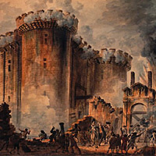
The National Assembly, 1789-1791

Slide 45
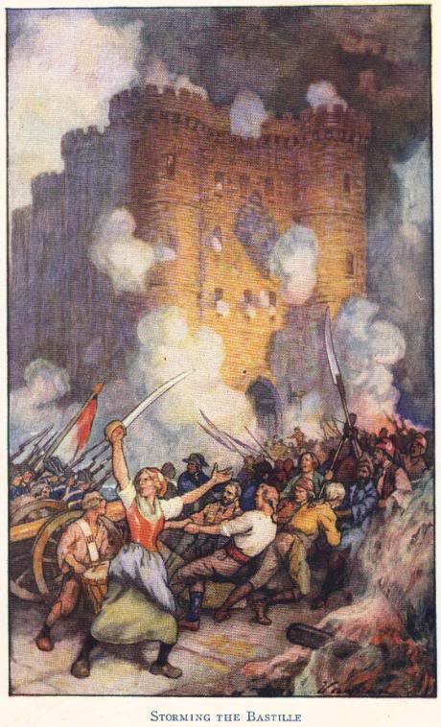
National Assembly (1789-1791)
Louis XVI did not actually want a written constitution
When news of his plan to use military force against the National Assembly reached Paris on July 14, 1789, people stormed the Bastille

Slide 46
Uprising in Paris
People of Paris seized weapons from the Bastille
July 14, 1789
Small groups – factions – competed to control the city of Paris
Uprising spread throughout France
Nobles were attacked
Records of feudal dues and owed taxes were destroyed
Many nobles fled the country – became known as émigrés
Louis XVI was forced to fly the new tricolor flag of France
Parisians organized their own government which they called the Commune

Slide 47
A. The Storming of Bastille (Historic)
1. Determined to reassert royal authority, Louis XVI ordered a mercenary army of Swiss guards to march toward Paris and Versailles. (Nothing says strong leadership quite like using a foreign army!)
2. In Paris, angry mobs were already protesting the soaring price of bread. As tensions rose, a mob stormed the Bastille, a royal fortress and prison. The mob freed a handful (7) of prisoners and seized the Bastille’s supply of gunpowder and weapons.
3. The fall of the Bastille marked an important symbolic act against royal despotism. It also pushed Paris to the forefront of the ongoing revolution.

Slide 48
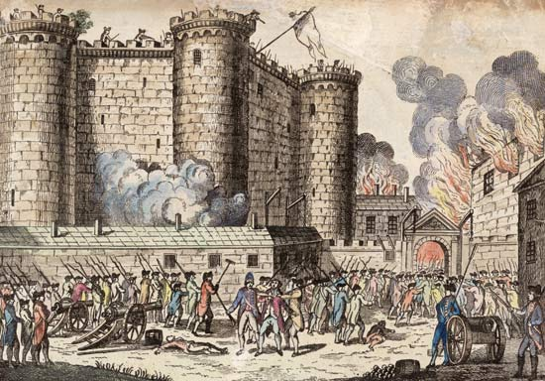

Slide 49
B. The Declaration of the Rights of Man and the Citizen, August 1789
1. The declaration proclaimed that all men were ‘born and remain free and equal in rights’. These natural rights included the rights to ‘liberty, property, security, and resistance to oppression’.
2. The declaration provided for freedoms of religion, speech, arbitrary arrest, press and the right to petition the government.
POLITICAL FACTOR

Slide 50
Declaration of the Rights of Man
Freedom of religion
Right of the people to create laws
Right to a fair trial
“Liberty, equality, fraternity!”
Freedom of the press
Guaranteed property rights
Freedom of speech

Slide 51
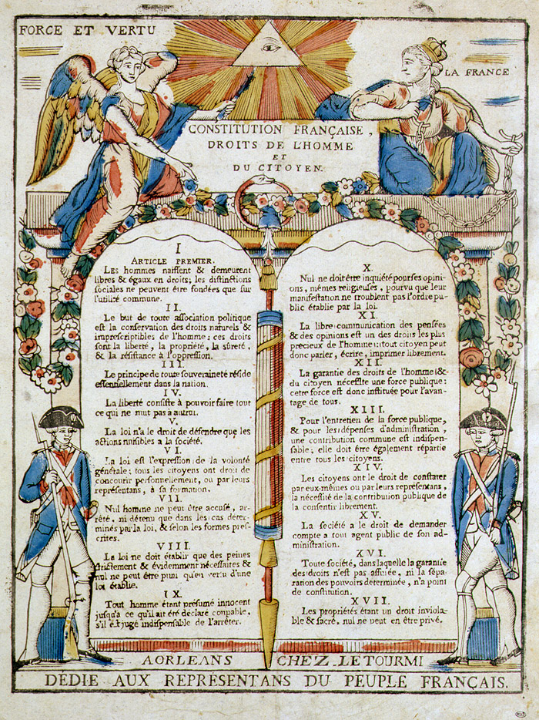

Slide 52
Declaration of the
UN - Universal Declaration of
Rights of Man
Human Rights
Men are free and equal
Liberty, ownership of property, security
Nation is sovereign
Limits to liberty determined by law
Law is an expression of the general will
Due process of the law
Presumed innocent until proven guilty
Freedom of religion
Freedom of speech and the press
Only state police, not personal
Equal taxation
Gov’t accountable to the public
Separation of powers
Right of property security
All people are equal
The right to own property
Rule of law
Everyone has the right to life, liberty, and security
Due process of law
Presumed innocent until proven guilty
Freedom of religion
Freedom of speech
Freedom of thought
Will of the people is the basis of a gov’ts authority
Limits on rights must be pros by law
Right to a nationality
No discrimination based on race or ethnicity.

Slide 53
C. The Rights of Women
1. Women gained increased rights to inherit property and to divorce. (However, this was to weaken feudal holds…not help women…)
2. Women did not gain the right to vote or to hold political office.
3. In her book, A Vindication of the Rights of Women, Mary Wolstonecraft argued that women are not naturally inferior to men. The appearance of inferiority is created by a lack of education.

Slide 54
Declaration of the Rights of Woman
Journalist Olympe de Gouges argued in her Declaration of the Rights of Woman that women are equal citizens and should benefit from governmental reforms just as men did.
Madame Jeanne Roland also served as a leader in the women’s rights movement, and was able to heavily influence her husband (a government official).
Women did gain some rights during the French Revolution, but these were designed for purposes other than liberating women.
Women could inherit property, but only because doing so weakened feudalism and reduced wealth among the upper classes.
Divorce became easier, but only to weaken the Church’s control over marriage.

Slide 55
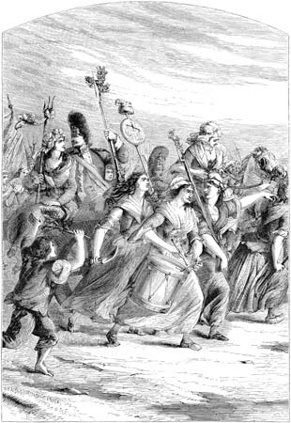
Goodbye, Versailles! Adieu, Versailles!
Parisian Commune feared that Louis XVI would have foreign troops invade France to put down the rebellion
Louis XVI’s wife, Marie Antoinette, was the sister of the Austrian emperor
A group of women attacked Versailles on October 5, 1789
Forced royal family to relocate to Paris along with National Assembly
Royal family spent next several years in the Tuileries Palace as virtual prisoners

Slide 56
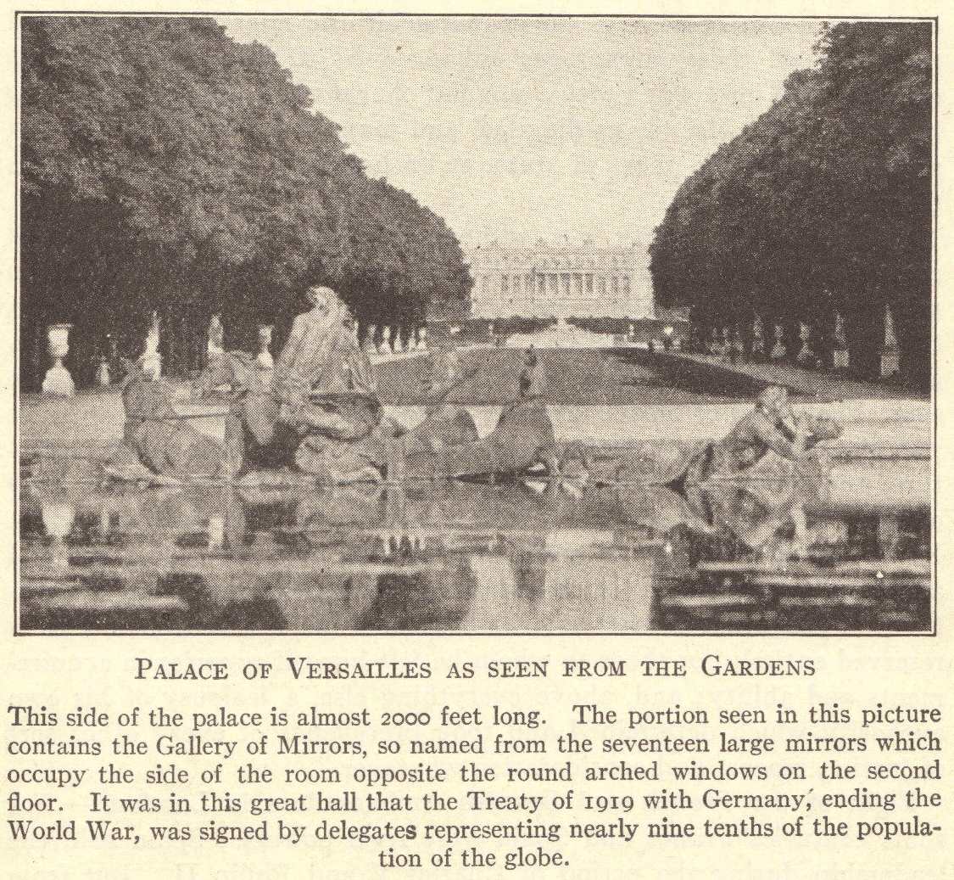

Slide 57
E. The Civil Constitution of the Clergy, August 1790
1. This act, passed by the National Assembly, did the following:
-confiscated the lands owned by the Roman Catholic Church
-Decreed that bishops and priests would be elected by the people and paid by the state
-Required the clergy to take a loyalty oath to support the new government
2. It is important to note that Pope Pius VI condemned the act and that over half of the clergy refused to take the oath of allegiance. Alienated Catholics proved to be persistent opponents of the French Revolution.

Slide 58
F. Reforms of the National Assembly
1. The National Assembly did
-create a constitutional monarchy
-divide France into 83 departments governed by elected officials
-establish the metric system of measurement
-abolish internal tariffs
-abolish guilds
2. The National Assembly did not
-abolish private property
-give women the right to vote

Slide 59
Constitution of 1791
Democratic features
France became a limited monarchy
King became merely the head of state
All laws were created by the Legislative Assembly
Feudalism was abolished
Undemocratic features
Voting was limited to taxpayers
Offices were reserved for property owners
This new government became known as the Legislative Assembly

Slide 60
Changes under the National Assembly
Abolishment of guilds and labor unions
Reforms in local government
Taxes levied based on the ability to pay
Many nobles left France and became known as émigrés
Declaration of the Rights of Man
Abolition of special privileges
Constitution of 1791
Equality before the law (for men)

Slide 61
Legislative Assembly (1791-1792)
Royal family sought help from Austria
In June, 1791, they were caught trying to escape to Austria
Nobles who fled the revolution lived abroad as émigrés
They hoped that, with foreign help, the Old Regime could be restored in France
Church officials wanted Church lands, rights, and privileges restored
Some devout Catholic peasants also supported the Church
Political parties, representing different interests, emerged
Girondists
Jacobins

Slide 62
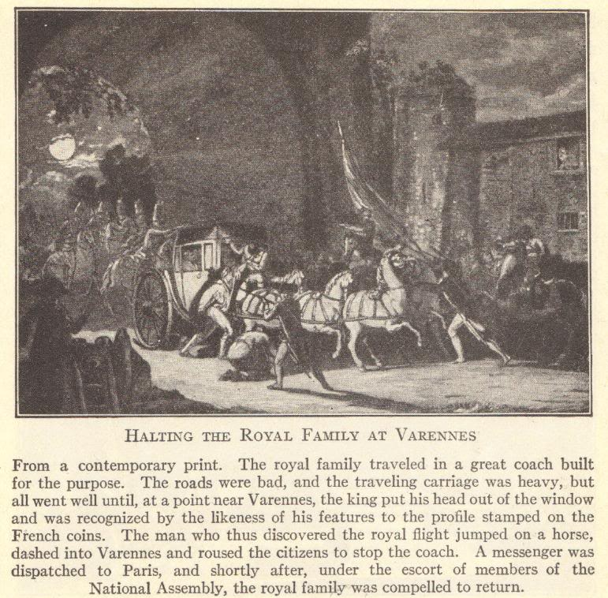

Slide 63
A. Factions in the Legislative Assembly
1. Members of the Legislative Assembly sat together in separate sections of the meeting hall. The political terms right, center and left are derived from the seating arrangement.
2. Conservatives who supported the king made up the Right.
3. Moderates comprised a large group in the Center.

Slide 64
4. Radicals who distrusted the king and wanted the Revolution to continue sat to the left. The Left was divided into two groups:
-Jacobins wanted to overthrow the monarchy and create a republic. Key Jacobin leaders included Jean-Paul Marat, Georges-Jacques Danton, and Maximilien Robespierre.
-Girondists wanted to involve France in a war that would discredit the monarchy and extend France’s revolutionary ideals across Europe.

Slide 65
Assembly key takeaways
1789 – The National Assembly rebels in the Estates General
Eventually popular support convinces the king to support this new government
Later that year, there is a march to Versailles (due to bread shortages) where the women capture the king and queen and put them under house arrest in Paris = the power of the king is declining

Slide 66
Assembly key takeaways #2
1791 – the king tries to escape, is captured and stripped of his powers. This leads to the establishment of the newly elected Legislative Assembly
This government ends up having to fight wars with Austria, then Prussia, then the Netherlands…

Slide 67
Convention (1792)
On September 22, 1792, the Convention met for the first time
Established the First French Republic
Faced domestic opposition and strife
Girondists were moderates who represented the rich middle class of the provinces
Jacobins (led by Marat, Danton, and Robespierre) represented workers
Faced opposition from abroad
Austria, England, Holland, Prussia, Sardinia, and Spain formed a Coalition invading France

Slide 68
Opposition to the New Government
European monarchs feared that revolution would spread to their own countries
France was invaded by Austrian and Prussian troops
In the uproar, the Commune took control of Paris
Commune was led by Danton, a member of the Jacobin political party
Voters began electing representatives for a new convention which would write a republican constitution for France
A republic is a government in which the people elect representatives who will create laws and rule on their behalf
Meanwhile, thousands of nobles were executed under the suspicion that they were conspirators in the foreign invasion

Slide 69
B. France Versus Austria and Prussia
1. Leopold of Austria and Frederick William II of Prussia issued the Declaration of Pillnitz (Aug. 1791) declaring that the restoration of absolutism in France was of ‘common interest to all sovereigns of Europe’.
2. The Legislative Assembly declared war against Austria and Prussia in April 1792, thus beginning the War of the First Coalition.
3. The war began badly for the poorly equipped French armies. By summer 1792, Austrian and Prussian armies were advancing towards Paris.

Slide 70
C. The Second French Revolution
1. Faced with defeat, recruits rushed to Paris singing the Marseillaise, a stirring appeal to save France from tyranny. The rejuvenated French forces stopped the Austro-Prussian army, thus saving the Revolution.
2. During the summer of 1792, radicals called sans-culottes (literally ‘without breeches’) took control of the Paris Commune (the City gov’t). The revolutionary Paris commune intimidated the Legislative Assembly into deposing Louis XVI and issuing a call for the election of a national convention. This new body would then form a more democratic government.

Slide 71
La Marseillaise - English lyrics
Arise children of the fatherland
The day of glory has arrived
Against us tyranny's
Bloody standard is raised
Listen to the sound in the fields
The howling of these fearsome soldiers
They are coming into our midst
To cut the throats of your sons and consorts
To arms citizens
Form your battalions
March, march
Let impure blood
Water our furrows
What do they want this horde of slaves
Of traitors and conspiratorial kings?
For whom these vile chains
These long-prepared irons?
Frenchmen, for us, ah! What outrage
What methods must be taken?
It is us they dare plan
To return to the old slavery!

Slide 72
Tri-color cockade: The colours red and blue were historic colours representing the city of Paris, white represented the monarchy. Wearing the cockade soon became compulsory for revolutionaries.
Bonnet Rouge: This red cap had its roots in ancient Greece. Roman slaves who had won their freedom wore the cap. During the Enlightenment, the cap became a symbol of liberty and the French took that meaning to heart. During The Terror, many wore the cap to show their support for the revolution (avoiding suspicion - and perhaps the guillotine - may have been incentives.)

Slide 73
Growing Coalition against the French
Convention drafted Frenchmen into the army to defeat the foreign Coalition (able bodies 15 – 25, single)
These troops were led by General Carnot
The people supported military operations because they did not want the country back under the Old Regime
Rouget de Lisle wrote the “Marseillaise”
Became the French national anthem
Inspired troops as they were led into battle
After two years
Coalition was defeated
France had gained, rather than lost, territory

Slide 74
3. Violence once again exploded in Paris. Convinced that royalists would betray the Revolution, mobs of sans-culottes executed over a thousand priests, bourgeoisie, and aristocrats. These ‘September massacres’ marked the beginning of a second French Revolution dominated by radicals.

Slide 75
The French Revolution Grows
Despite the noise and confusion, something remarkable was going on in the minds of French people at this time: they were becoming nationalistic. They had taken a hand in their own destiny and created a new nation state (a democratic state). And the French army, to the surprise of everyone, turned back the Prussian army at Valmy (September 20, 1792). This boosted the morale of the people of France tremendously; they saw themselves as the victorious champions of liberty, successfully resisting the forces of autocracy.

Slide 76
Abolishment of the Monarchy
The Convention abolished the monarchy
As long as the royal family lived, the monarchy could be restored
Put the royal couple on trial for treason
Convictions were a foregone conclusion
Louis XVI was guillotined on January 21, 1793
Marie Antoinette was guillotined on October 16, 1793
Daughter Marie-Thérèse was allowed to go to Vienna in 1795
She could not become queen because of Salic law, which did not allow females to succeed to the throne
Son Louis-Charles, a.k.a. Louis XVII (lived 1785-1795) was beaten and mistreated until he died in prison

Slide 77
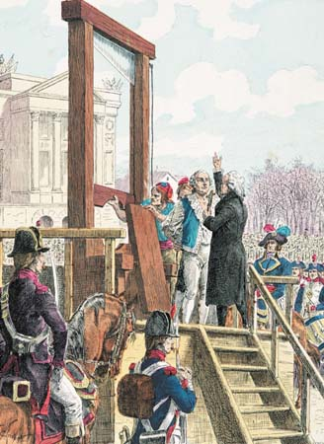
A. The Execution of Louis XVI
1. The newly elected National Convention abolished the monarchy and declared that France was now a republic.
2. The National Convention then had to decide Louis XVI’s fate. The Girondists favored imprisonment while the Jacobins demanded that he be executed as a tyrant and a traitor.
3. After a contentious debate, the National convention passed a resolution condemning Louis XVI to death. The resolution passed by 1 vote!

Slide 78
Said Robespierre…
Regretfully I speak this fatal truth -- Louis must die because the nation must live…
I propose that you take immediate legal action on the fate of Louis XVI. . . . I ask that the National Convention state that from this moment on he is a traitor to the French nation and a criminal against humanity.

Slide 79
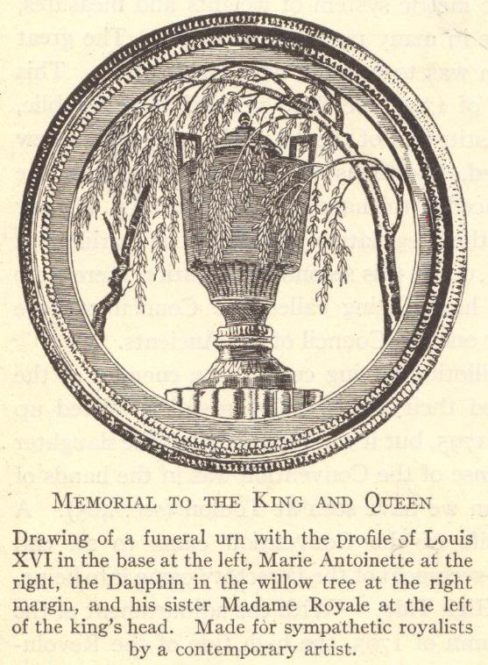

Slide 80
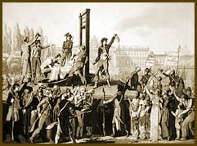
The roots of the story, or poem, of Jack and Jill are in France. Jack and Jill referred to are said to be King Louis XVI - Jack -who was beheaded (lost his crown) followed by his Queen Marie Antoinette - Jill - (who came tumbling after). The words and lyrics to the Jack and Jill poem were made more acceptable as a story for children by providing a happy ending! The actual beheadings occurred in during the Reign of Terror in 1793. The first publication date for the lyrics of Jack and Jill rhyme is 1795 - which ties-in with the history and origins. The Jack and Jill poem is also known as Jack and Gill - the mis-spelling of Gill is not uncommon in nursery rhymes as they are usually passed from generation to generation by word of mouth.
www.rhymes.org.uk/jack_and_jill.htm
Jack and Jill went up the hill to fetch a pail of water Jack fell down and broke his crown And Jill came tumbling after. Up got Jack, and home did trot As fast as he could caper He went to bed and bound his head With vinegar and brown paper.

Slide 81
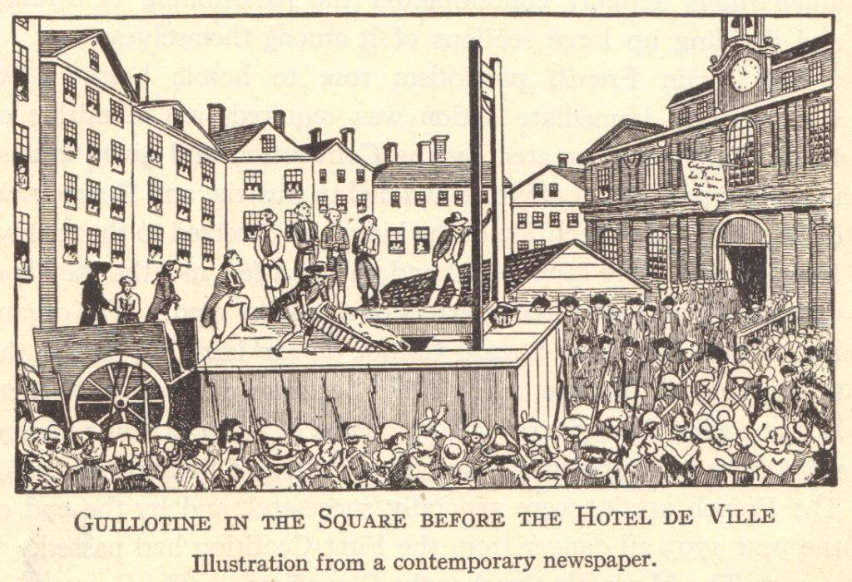

Slide 82
4. Supported by the sans-culottes, the Jacobins branded the Girondins as counterrevolutionaries and ousted them from the National Convention.

Slide 83
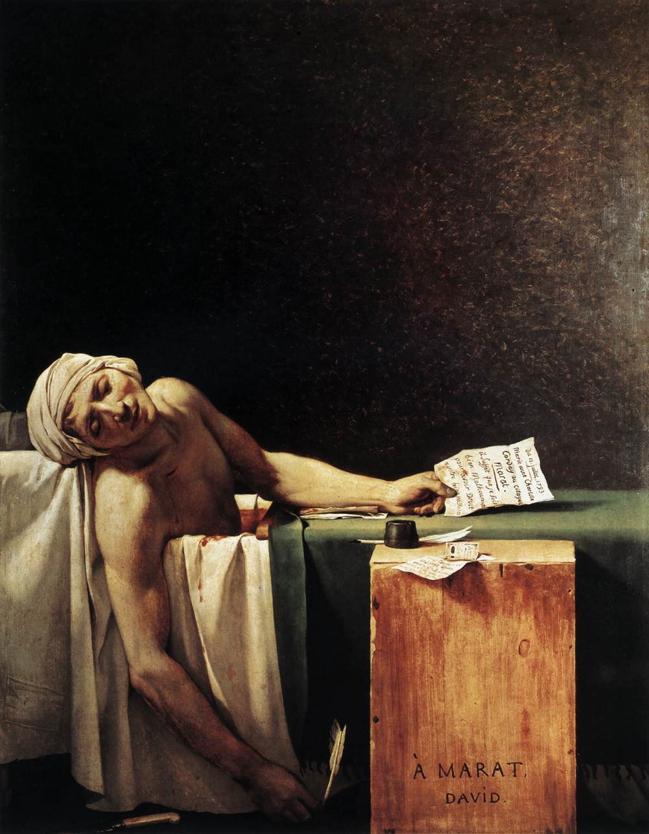
The three most memorable Jacobins were Georges Danton, Maximilien Robespierre, and Jean-Paul Marat.
Because of a debilitating illness, Marat was eventually forced to work from home. He was assassinated (in the tub while taking a medicinal bath) by Charlotte Corday, a Girondist sympathizer, in July, 1793.
I call him Bathtub Jesus.
The Death of Marat by Jacques-Louis David

Slide 84
B. European Reaction
1. At first, European liberals supported the French Revolution and applauded the fall of the Old Regime.
2. The English statesman Edmund Burke offered a conservative critique of the French Revolution. Burke warned that mob rule would lead to anarchy and ultimately military dictatorship. To many moderate Europeans, the Sept. massacres and the execution of Louis XVI vindicated Burke’s dire predictions.

Slide 85
So begins the reign of terror (We’re still in the Convention era)

