Slide 1
The French Revolution and Napoleon
1789-1815

Slide 2
D. The Reign of Terror
1. Faced with foreign invaders and the threat of domestic rebellion, the National Convention established the Committee of Public Safety to defend France and safeguard the Revolution.
2. Led by Robespierre, the Committee of Public Safety exercised dictatorial power as it carried out a Reign of Terror.
3. In the name of creating a Republic of Virtue, Robespierre executed the queen, his chief rivals, and thousands of ‘dangerous’ class enemies.

Slide 3
Convention drafted Frenchmen into the army to defeat the foreign Coalition
These troops were led by General Carnot
The people supported military operations because they did not want the country back under the Old Regime
Rouget de Lisle wrote the “Marseillaise”
Became the French national anthem
Inspired troops as they were led into battle

Slide 4
E. The ‘Nation in Arms’
1. While the Terror crushed domestic dissent, Robespierre turned to the danger posed by the First Coalition. In 1793, the Committee of Public Safety proclaimed a ‘levee en masse’ decreeing compulsory military service for all men between the ages of 18 and 40.
2. The levee en masse created a national military based upon mass participation. This marked the first example of the complete mobilization of a country for war.

Slide 5
3. Motivated by patriotism and led by corps of talented young officers that included Napoleon Bonaparte, France’s citizen-soldiers defeated the First Coalition’s professional armies.
4. After two years
Coalition was defeated
France had gained, rather than lost, territory

Slide 6
F. The Thermidorian Reaction
Members of the Girondist political party tried to end the Reign of Terror initiated by the Jacobin political party
This opposition to the Committee of Public Safety caused many Girondists to be tried and executed for treason
Eventually, even Georges Danton wanted to end the executions
This resulted in Danton being tried and executed for treason
Maximilien Robespierre became leader of the Committee of Public Safety
He continued the executions
Convention came to blame Robespierre for the Reign of Terror
Thermidorean Reaction
July 27, 1794 – ended the Reign of Terror
Convention sent Robespierre and other members of the Committee of Public Safety to the guillotine
Robespierre was guillotined on July 28, 1794

Slide 7
3. Robespierre’s death ended the radical phase of the French Revolution. On the new revolutionary calendar, July was called Thermidor from the French word for ‘heat’. Hence, the revolt against Robespierre is called the Thermidorian reaction.

Slide 8
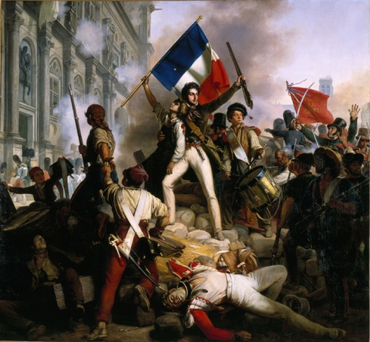
VI. The Directory , 1795-1799

Slide 9
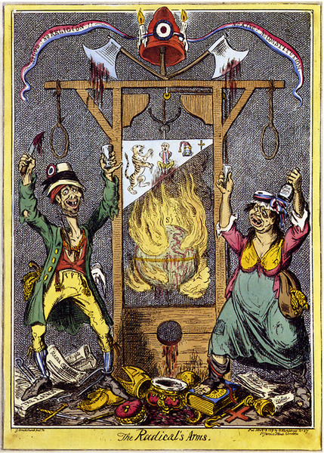
Reign of Terror Sets Stage for Napoleon
Radicals lead by Maximilien Robespierre attempts to remake France into a “republic of virtue” with no trace of the Catholic Church or Monarchy. Anyone who is even suspected of questioning the revolution faces the guillotine by order of the “Committee of Public Safety”.
Thousands are executed during the “Reign of Terror” in 1793 & 1794. The Terror eventually ends when Robespierre himself is executed.
France comes under control of more moderate & conservative leaders who form yet another government called the “Directory”. This government promises to “restore order” to France. The leaders of the Directory turn to the military for help…
Is the cartoon supporting or criticizing the radicals? Explain

Slide 10
A. Bourgeoisie Misrule
1. The government consisted of a two-house legislature and an executive body of five men known as the Directory. (The lower house proposed laws, the upper house voted on laws.)
2. Dominated by rich bourgeoisie, the Directory proved to be corrupt and unpopular.

Slide 11
The Directory did…some things
(Re)Adopted the metric system
Established a nationwide system of public education
Ended slavery in France’s colonies
Dealt the final blow to feudalism by abolishing primogeniture (the system whereby the oldest son inherited all of his father’s estate)
Ended debt imprisonment
Drew up a comprehensive system of laws

Slide 12
The Directory suffered from corruption and poor administration.
The people of France grew poorer and more frustrated with their government.
Despite, or perhaps because of, these struggles, the French developed a strong feeling of nationalism – they were proud of their country and devoted to it.
National pride was fueled by military successes.
It would be a military leader – Napoleon Bonaparte, coming to power through a coup d’état – who would end the ten-year period (1789-1799) known as the French Revolution.

Slide 13
B. The Fall of the Directory
1. Public discontent mounted as the Directory failed to deal with inflation, food shortages and corruption.
2. On November 9, 1799, an ambitious and talented young general named Napoleon Bonaparte overthrew the Directory and seized power.

Slide 15
Napoleon
Born in Corsica, not France
Became second-lieutenant in artillery at age 16.
Series of military victories – and promotions – would follow for Napoleon. In 1795 he stops a pro-royalist coup.
Over the next few years more victories come over Italians and Austrians. The French love him!

Slide 16
Napoleon
Napoleon overstretches between 1797 and 1798. English put him in his place, sinking ships and stopping many of his advances.
Directory fears him, sending him to Egypt to keep him occupied.
They have a right to be afraid. When Napoleon hears about troubles in France in 1799 he comes back…and takes over.

Slide 17
Napoleon’s Coat of Arms

Slide 18
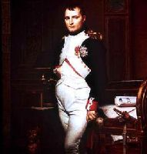
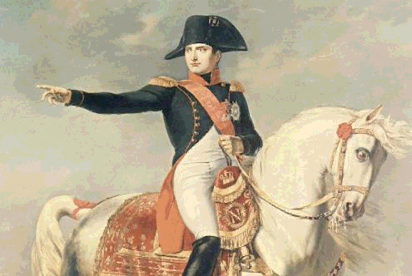
Napoleon Bonaparte
Was born in 1769 in French controlled island of Corsica to a middle class family, attended military school & joined army at 16
Became a General at 27 years old and considered military “genius” in war with Prussia & Austria during the Revolution
Quickly became a national hero during the revolution and war with Austria & Prussia because of victories he led and inspiring his men to “save” France

Slide 19
Napoleon Seizes Political Power
The leaders of the Directory were corrupt and many feared a return to the Reign of Terror by 1799
Napoleon aggressively assumes power with support of French military (rules until 1814)
This quick seizure of power called a “coup d’etat”
Pronounced: koo dey-tah
Definition: a sudden and decisive action in politics, especially one resulting in a change of government illegally or by force.
Directory is dissolved
Napoleon makes himself “1st Consul” of France = Dictator
In 1800 France votes for yet another new constitution
The 5th form of government in ten years!
Napoleon wins “Plebiscite” – a vote by the people to approve of the new constitution and make Napoleons rule “official”

Slide 20
Napoleon Brings Changes to France
Stabilizes French Economy
Fairer tax, currency & banking system established
Reduced government corruption
Runs government in a my systematic & “military” manner
Government jobs & promotions were based on merit (not connections)
Established Lycées (free public schools)
Majority of citizens could attend school for the first time
Made peace with the Catholic Church (Concordat)
Traditional religion allowed again
Re-Writes Laws of France…see next slide

Slide 21
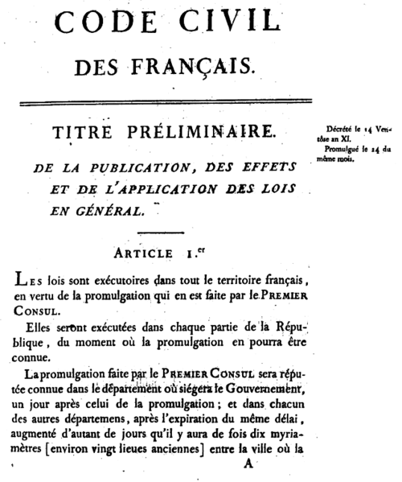
Napoleonic Code of National Laws Established
Comprehensive new set of written laws created under leadership of Napoleon
Establishes stability with consistent national laws
Ensured rights of peasants
Eliminated many tax injustices
However:
Reduces women’s rights
Restricted freedom of speech & the press
Restored slavery in French colonies

Slide 22
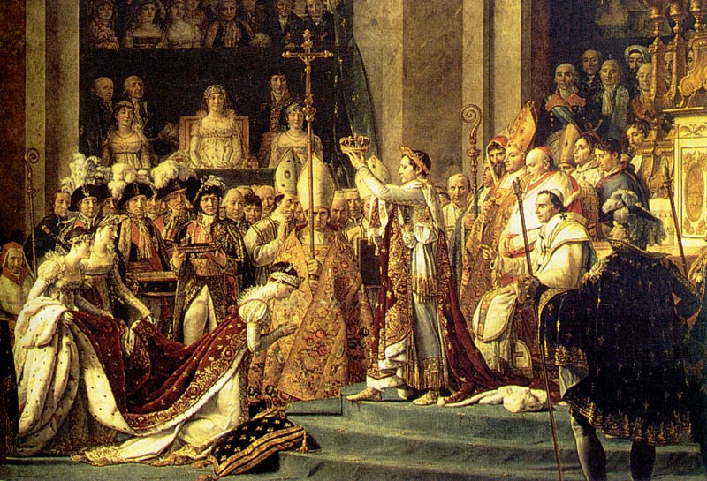
Napoleon Builds an Empire
1804 Napoleon declares himself emperor for life (not “1st Consul”) and another “plebiscite” approved this.
What is relevance of image below?

Slide 23
Napoleon Attempts to Conquer Europe
Napoleon sells Louisiana territory in North America to US to finance military exploits in Europe…aka the “Napoleonic Wars”
Napoleon won victories against Austria, Prussia, Switzerland & Italy – French armies dominate Europe for about 10 years in the early 1800’s
Countries forced to sign peace treaties with France granting Napoleon direct or indirect control over most of continental Europe…see map on next slide
Napoleon turns attention towards England but loses naval Battle of Trafalgar in 1805 and abandons plans to take over England

Slide 24
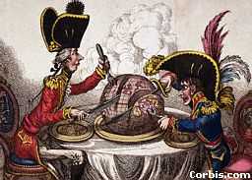
Napoleon Battles England for world dominance 1803-1815

Slide 25
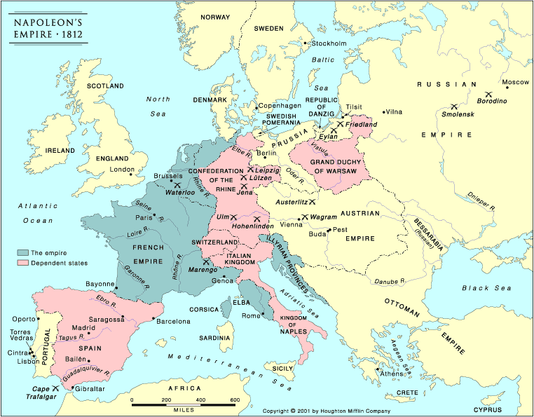
Napoleon’s Empire by 1812: Huge but UNSTABLE

Slide 26
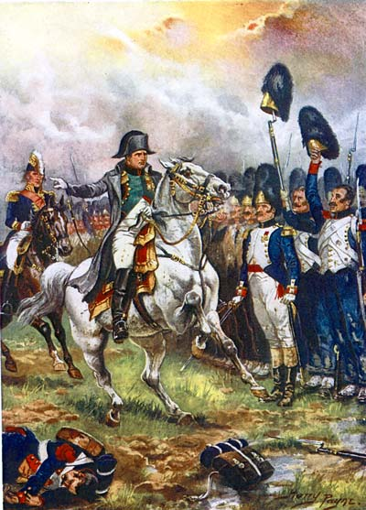
Napoleon’s Decline
3 main reasons:
1) His excessive ambition and egotism
2) The “Continental System” of European economic control by France fails…conquered nations do not “buy in” when economic problems hit under Napoleonic rule
3) Overextension of his armies. Tries to fight in too many places at the same time and spreads French armies too thin.
Example: Fighting in Spain/Portugal (Peninsular Campaign) to the west at same time as battling Russia/Germany/Austria to the east (Scorched Earth Policy)
Eventually too many enemies “gang up” on Napoleon for his armies to handle
British, Russians, Prussians & Swedish (among others) all join together and defeat Napoleon

Slide 27
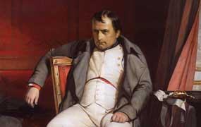
End Results of Napoleon’s Rule
Napoleon captured and exiled in 1814, escapes in 1815, attempts a “comeback” and loses before he is finally (permanently) exiled until his death of cancer in 1821
The Napoleonic Wars did not provide any lasting gains for France
The Napoleonic Code & some government reforms proved lasting
“He was as great as a man can be without virtue” says famous French historian of Napoleon
Unintentionally increases nationalism across Europe…

Slide 28
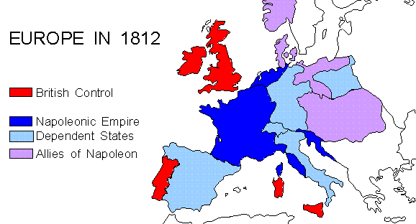

Slide 29
French Pride & National Memory
The development of nationalism can take different courses. It may be achieved through revolution or in response to aggression. It may be shaped by a growing sense of who “we” are and the bonds that connect individuals of a nation. For nations such as France, the sense of “we” and the bonds are expressed in its national memory.

Slide 30
Napoleon’s Defeat
Campaign of 1812 against Russia - 600,000 men in the Grande Armee - 40,000 only returned to France. Russians used a “scorched earth policy”. During the Winter months the Russians defeated Napoleon.
1813 Battle of Leipzig -- Napoleon lost
1814 April 11 - abdicated - exiled to island of Elba
1815 February - escaped from Elba - marched to Paris in the “Hundred Days” - soldiers rushed to fight under Napoleon
Battle of Waterloo - Wellington defeated Napoleon
Exiled to St. Helena - very remote location with little chance of escape, died in 1821 supposedly of cancer but now it is believed that his wine was poisoned with arsenic

Slide 31
Accomplishments
In 1802, he brought victory to France and peace to Europe
Napoleonic Code - centralized government, included many democratic principles such as religious freedom, jury trial, outlawing serfdom and fair legal methods.
University of France - set the pattern for modern dictators by making sure schools taught what he wanted them to!
Bank of France - Napoleon organized the bank, efficiently collected taxes, and encouraged business
Concordat - agreement with the pope to once again make the Catholic Church official in France. In exchange, the pope gave up all claims to lands taken from the Church by the National Assembly.
Improvements to France - public works, improved roads, dug canals, etc.

