Slide 1
REC 3045 Periodization

Slide 2
Why is Periodization Important?
For Peak Performance?
Systematic and Scientifically proven method
Allows training at the optimum level
For Injury Reduction?
Prevents overtraining without undertraining
For Non Athletic Populations?
Injury prevention with unknown levels of fitness

Slide 3
Why are Need Assessments Important?
Importance of Initial Consultation & Health Status
Reveals ability and level of work that the person can perform at
Reveals potential injury which could limit the person or harm them
Results in an appropriate program design for the person
Fitness Testing (Including Baseline Testing and Post-Training Testing)
Results become measurable

Slide 4
What are the following Acute Training Variables?
Exercises: Different exercises develop the body in different ways
Plyometrics, Power, Controlled Speed etc
Order of Exercises: Controls the effect on the muscles
Largest to Smallest unless we are targeting a muscle in a different manner
Repetitions: Number of reps determines how the body will react to the work
Sets: Amount of sets performed determines how the body will react
Tempo: Refers to the speed of the rep or workout
Develops power
Rest: Determines how the body will recover
Different recovery rates result in different reactions by the body
Load (Intensity): How hard we are working

Slide 5
Manipulate the Variables to Create Training Programs
Manipulate the variables to create the following programs:
Muscular Endurance
Hypertrophy
Max Strength
Power

Slide 6
The Traditional Periodization Model
*4 periods
-Preparatory Period
-Hypertrophy/Endurance Phase
-Basic Strength Phase
-Strength/Power Phase
-First Transition Period
-Competition Period
-Maintenance
-Second Transition Period
-Period of Active Rest

Slide 7
General Adaptation Syndrome
3 Responses to Training Stress
*Shock or Alarm Phase
*Resistance Phase
*Exhaustion Phase

Slide 8
Shock or Alarm Phase
Stress detected (alarm goes off)
Fight or Flight response
(adrenalin is produced)
In Training, we want a Fight Response
Training is a series of SHOCKS to our body that we want our body to FIGHT

Slide 9
Resistance Phase (Super Compensation)
Our body responds to stress by compensating
Compensating means getting stronger to meet the demands of the stress
So long as we allow enough time after the stress for the body to compensate (Recover) it will get stronger

Slide 10
Exhaustion Phase (Decompensation)
If we continually not allow enough time for the body to compensate (enough recovery time) it will decompensate or get weaker
When our body gets to the Exhaustion Phase it takes a great length of time before we get to supercompensation again (It is like having mono/body is rundown)

Slide 11
The Stress Rest Principle (Resistance/Exhaustion)
RECOVERY
A
A
A
DECOMPENSATION
B
GROWTH (SUPERCOMPENSATION)
RECOVERY TIME IN DAYS
The body needs at least 2 days (48 hours) to recover. The greater the intensity the more recovery time required.

Slide 12
What is the First Transition Period of an ATP Periodization Model?
It is a period between the Preparatory Period and the competitive Period
Athletes typically Taper or Ramp their work
Tapering: Reducing workload to allow the body to fully recover so it is at its strongest for the competitive period
Ramping: Elevating the Intensity of the workload to simulate the intensity of the competitive period

Slide 13
What is the Competitive Period?
This is the time when games and competitions count
It is the highest level that the athlete will work at

Slide 14
What is the 2nd Transition Period?
This is the time after the competitive period when the athlete needs to take a break from high competition to mentally and physically recuperate
Athletes will typically use Active Rest where they get involved in other activities that they enjoy while remaining active physically
They will not get involved in their sport

Slide 15
Specific Time Periods (Cycles)
*Macrocycles
- 3 or more weeks of workouts
*Mesocycles
- single workout or less
*Microcycles
-1-3 weeks of workouts
How will you use these 3 cycles in your 2 month periodized plan? Explain

Slide 16
4 Sport Seasons
*Off Season Period
*Pre Season Period
*In Season Period
*Post Season Period
How do the 4 periods of the traditional periodization model fit into the 4 Sport Seasons?

Slide 17
Periods of Injury Rehabilitation Periodization Plan
↓ swelling, pain, inflammation
↑ ROM
↑ muscular strength, endurance, power
Maintain cardiovascular fitness
Re-establish neuromuscular control
Improve stability and balance
Address psychological reaction to injury/pain
Posture & core stability
Protect/prevent further injury
Kinetic Chain/ Jt above/below
Functional Progressions- sport specific
Return to Activity Criteria
Home Program
Notes:
Need to work through Pain free ROM through goals

Slide 18
Phases of Healing
Overlap with each other
Inflammatory Phase: 2-4 days, SHARP/D, Goals; 1-3,9
Fibroblastic-Repair Phase: first few hours post injury to 4-6 weeks, Goals; (1-3), 4-9, (10-11)
Maturation- Remodeling Phase: 3 weeks to several years, Goals; (1-9), 10-13
Notes:
Inflammatory Phase: Swelling, Heat , Redness, Altered Function, Pain, Deformity
**Critical- if this response does not accomplish what it is supposed to, or if it does not subside, normal healing cannot take place
Fibroblastic Repair- period of scar formation
Maturation- Remodeling Phase: realignment or remodeling of the collagen fibers that make up scar tissue according to the tensile forces which the scar is subjected too.

Slide 19
Swelling, Pain and Inflammation
PRICE –Protect, Rest, Ice, Compression, Elevation for the first 72 hours
Rest- Active Rest or AAROM (active-assisted ROM)
Ice- Decreases pain, vasoconstriction of vessels to control hemorrhage(bleeding) and edema (swelling)
Compression-decreases hemorrhage and hematoma formation
Elevation- reduces internal bleeding
Notes:
If swelling is controlled, the time for rehab is reduced
Rest- usually 72 hours before rehabilitation program
Ice- slows the speed of nerve transmissions
Compression- mechanically reduces the space available for swelling to accumulate, tensors, foam pads
Elevation- eliminates the effect of gravity on blood pooling in extremities, and assists with lymphatic sys. Which drains blood and other fluids from the area

Slide 20
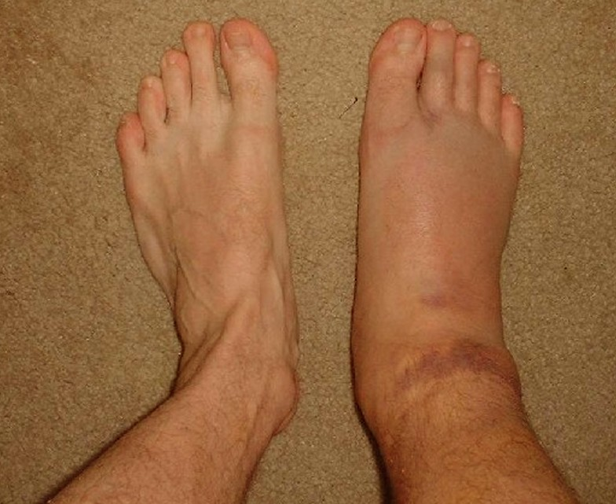
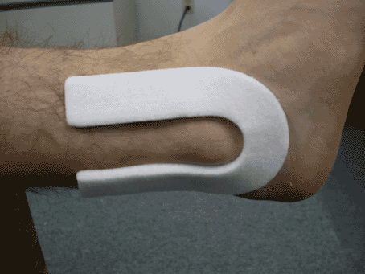
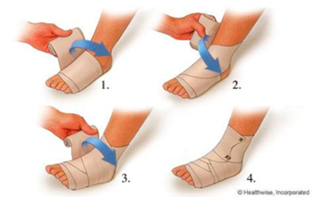

Slide 21
ROM (Range of Motion)/Flexibility
Several factors can limit flexibility and ROM: shape of jt, capsule, ligaments, mm, scars, neural tissue
Reflex Autogenic Inhibition: Golgi Tendon Organs = relaxation in antagonist mm
Flexibility can be lost quickly
Can be maintained with 1 session/week
Need 3-5 sessions a week to improve!
Notes:
GTO- after stretching for 6 seconds GTOs override muscle spindle to cause muscle to relax.
Static/ Passive stretching= 15-60 second holds 3- 5 repetitions most effective for increasing flexibility 3-5x/week
Dynamic stretching- no longer than 6 sec holds, do not want to relax the muscle

Slide 22
Muscular Strength, Endurance and Power
MUST use ALL 3 (ISOM,CONC,ECCEN) for program, watch out for Rehabilitative Overload
First weeks of program is focused on training to be efficient ex. Technique, target fiber and contraction
Strength directly related to efficiency of neuromuscular sys; increase motor unit recruitment, firing rate, enhancing synchronization of motor unit firing
Notes:
ISOMETRIC- mm contracts, no change in mm length (static strength, decrease atrophy) CONCENTRIC- mm contracts, mm shortens to move resistance ECCENTRIC- mm contracts, mm lengthens to move resistance
Athlete will have increased pain and swelling if there is rehabilitative overload
ISOM (inflam/fibro phase)- contract 10 secs of 10 or more contractions/hr, Concentric- 1-2 seconds of lift, eccentric 2-4 seconds of lift (RATIO SHOULD BE 1:2)
Type 1 fibers- slow, resistant to fatigue- endurance
Type 2- fast, for powerful force
a- fast, moderate resistance to fatigue
b- fast, fatigue rapidly

Slide 23
Maintain Cardiorespiratory Fitness
Critical and often most neglected, improvements may be lost in as little as 12 days
Regardless of training schedule/techniques; Main goal is to increase ability of Cardioresp sys. to supply a sufficient amt of oxygen to the mm.
Upper vs Lower body injury
Notes:
Dependent on sport
Decrease in oxygen can affect how fast you recover with an injury
Upper body- bike, treadmill, pool, elliptical
Lower body- pool, arm ergometer, bike
Aerobic/ anaerobic exercise

Slide 24
Re-establish Neuromuscular Control
After injury, the CNS “forgets” how to put together information from mm and jt receptors
Attempt to teach the body conscious control of a specific movement
Requires many repetitions, from simple to complex movements
CNS will compare the specific movement with stored information and adjust until any discrepancy in movement is corrected.
MOST critical during the early stages of rehab to avoid reinjury
Notes:
4 components:
Proprioception (position of jt in space) & Kinesthesia (ability to detect movement)
Dynamic Stability
Preparatory and reactive mm characteristics
Conscious and unconscious functional motor patterns
An unstable platform promotes reactive muscle activity- attempting to balance on a platform- manually perturb

Slide 25
Improve stability and Balance
Involves integration of muscular forces, neurological sensory information, and biomechanical information
Alignment of joint segments in an effort to maintain COG within an optimal range of the max limits of stability
Static and Dynamic stability
Associated with Closed Kinetic Chain (fixed base of support)
Notes:
Re-establishing neuromuscular control is one part of balance
Maintaining COG within the base of support
Static: COG is maintained over a fixed base of support- on a stable surface- double, single leg, or tandem stance
Semidynamic- maintain COG on a moving surface, or unstable surface- foam, trampoline, mini squats
Dynamic- base of support is changing, forcing COG to adjust- balance beam, bounding

Slide 26
Psychological Reaction to Pain/ Injury
Psychological and sociological consequences of injury are just as debilitating as the injury itself
Can have an adverse impact on RTP
Barriers to rehabilitation
Focus on prevention: Listen, Educate on injury and rehab, Goal setting, Meditation/Progressive Relaxation, Imagery, REFERRAL
Maintain confidentiality!

Slide 27
Posture and Core Stability
Core= Lumbo-pelvic-hip complex, location of COG and where all movements begin
Weak core= fundamental problem of many inefficient movements that lead to injury
Inner (pelvic floor mm, TA, multifidus, diaphragm) and Outer unit (posterior oblique, deep longitudinal, anterior oblique, lateral)
If one sys is out of alignment= patterns of dysfunction= Mechanical imbalance= bad posture (kyphosis, lordosis, sway back)
Notes:
NEED ALL 5 ( don’t forget scapular stability)
POST OB: glute max, contralateral lat
Deep longitudinal- ES, biceps femoris, ligaments – Glute hamstring ES
Anterior Oblique- internal and external obliques and contralateral adductors
Lateral- glute med and min and contralateral adductors
Simple exercises first then complex, need proper activation with any activity

Slide 28
Protect and Prevent
Equipment= Helmets!, facial protection (face, throat, mouth, ears, and eyes), neck protecting, trunk and thorax, hips/ buttock, groin/ genetalia, upper leg, lower leg, footwear
Protect with injury= crutches, splints, tensors, tape, slings, foam padding
Rehab program must allow for Rest!
Notes:
Helmets- guidelines for purchasing and requirements for each sport, guidelines for reconditioning and properly fitting
Sports that have helmets: Football, hockey, lacrosse, cycling, baseball, soccer headgear
Cervical collars
Trunk/ thorax- shoulder pads, bras (stretch ligaments, premature sagging)

Slide 29
Kinetic Chain
Kinetic Chain- integrated functional unit, includes mm, fascia, ligaments, tendons, articular sys, and neural sys
Open- Kinetic Chain Exercise- distal segment is mobile and not fixed (foot or hand not in contact with ground or surface)
Closed-Kinetic Chain Exercise- when the distal segment of the lower extremity is stabilized or fixed
Notes:
Joint above and below
If any system with the kinetic chain not working efficiently, other sys forced to adapt and compensate- leads to tissue overload, decreased performance, and predictable patterns of injury
Closed- associated with weight bearing activities and the lower extremity , minisquats, push ups,lunges, wall slides, leg press, stair climbing/ step ups, stationary bike, trampoline, BAPS board, slide boards, usually multi jt
Open- non-weight bearing, not all upper body exercises are open some closed, bicep curls, triceps extensions, bench press, leg curl/extension- more isolating exercises to target certain muscles, usually one jt

Slide 30
Functional Progressions
A series of gradually progressive activities designed to prepare the individual for RTP
Progress from simple to complex sport specific skills
Skills are broken down into component parts and the athlete gradually reacquires those skills within the limitations of progress
May be broken down into 3 phases: stabilization, strengthening, power
Notes:
Limitations- pain free ROM and strength
Slow to fast, light to heavy, short to long
Stabilization- correct deficits in structural integrity- mm, jt dysfunctions, neural deficits, postural control/stability (first phase don’t early)
Strength- enhance stabilization strength and endurance during functional movement patterns by incorporating high volume resistive exercises- force motor unit recruitment after prime movers are fatigue (change neuromuscular sys by increasing cross sectional diameter of mm, resis. To fatigue etc)
Power- first use multi planar ISOM,CONC,ECCEN exercises, train at 30-45% of max strength and accelerating through entire ROM , enhancing neuromuscular efficiency and power production by increasing motorneuron excitability which increase speed strength through entire ROM
Should not increase pain or swelling

Slide 31
RTP Criteria
Physicians Release
Pain Free
No swelling
Normal ROM
Normal Strength
Mentally Prepared
Pass Functional Tests!
Notes:
Functional tests- involves a single maximal effort performed to indicate how close the athlete is to a full return
Agility runs (figure 8s, shuttle run, carioca), sidestepping, vertical jumps, Hopping/bounding time or distance

Slide 32
Program Design [PF 30]
*Needs Analysis
evaluation of sport/assessment of athlete
*Exercise Selection
exercise type/movement analysis of sport
*Training Frequency
training status/sport season/training load
*Methods of Exercise Order
power, core, assisted/upper & lower body
push & pull/supersets & compound set

Slide 33
Program Design
*Various Training Loads
one rep max/predicted one rep max
loads based on training goals
(hypertrophy/power/endurance/strength)
*Various Rest Periods
strength & power (2-5 minutes)
hypertrophy (30 seconds – 1.5 minutes)
muscular endurance (0-30 seconds)
*Recovery
48 hours/72 hours

Slide 34
What is your sport and what are the needs of your sport?
What areas will you want to assess?
What are important movements of your sport?
What are the exercise types you will use?
What is your training status? Beginner/Intermediate/Advanced
What season are you in?

Slide 35
Outline the methods of exercise order?
power/core/assisted upper/lower
push/pull supersets/compound sets
Outline training loads?
% of one rep max
loads based on training goals (which programs and what are the goals)
9. Outline the rest intervals of each program?

Slide 36
Program Design (Aerobic)
*Various Exercise Modes
running/biking/skipping/other
*Various Training Frequencies day/week/month
*Various Training Intensities
heart rate monitoring/perceived exertion
*Various Training Durations
70% VO2 Max = several hours

Slide 37
Outline the exercise progression you will use to train aerobically during your periodization plan?
-increasing frequencies
-intensities
-duration
-rest period of aerobic activity

Slide 38
Oct 14
Oct 15
Oct 16
Oct 17
Oct 18
Oct 19
Oct 20
Oct 21
Oct 22
Oct 23
Oct 24
Oct 25
Oct 26
Oct 27
Oct 28
Oct 29
Oct 30
Oct 31
Nov 1
Oct 3
Oct 4
Oct 5
Oct 6
Oct 7
Oct 8
Oct 9
Oct 10
Oct 11
Oct 12
Oct 13
Sept 26
Sept 27
Sept 28
Sept 29
Sept 30
Oct 1
Oct 2
REC 3045 PERIODIZATION PLAN NAME:Football/Rugby
DATE
SEASON OF PLAY
In Season
SPORT SCHEDULE
Short Practice
Practice
Off
Off
Off
Off
Off
Off
Off
Off
Semi Final
Off
Off
Video
Practice
Practice
Practice
Video
Practice
Practice
Practice
Practice
Practice
Practice
Video
Practice
Practice
Video
Practice
Practice
Game
Video
Game
Practice
Practice
Practice
Game
PERIOD OF PLAN
Competitive
Strength 2
Strength 2
PROGRAM
Hypertrophy 1
Hypertrophy 1
Full Body W.O.
Hypertrophy 1
Hypertrophy 1
Hypertrophy 1
Strength 2
Strength Testing
Hypertrophy 2
Hypertrophy 2
Hypertrophy 2
Semi Final
Circuit
Circuit
Circuit
Strength 1
Strength 1
Strength 1
MACROCYCLE
MICROCYCLE
MESOCYCLE

Slide 39
Nov 2
Nov 3
Nov 4
Nov 5
Nov 6
Nov 7
Nov 8
Nov 9
Nov 10
Nov 11
Nov 12
Nov 13
Nov 14
Nov 15
Nov 16
Nov 17
Nov 18
Nov 19
Nov 20
Nov 21
Nov 22
Nov 23
Nov 24
Nov 25
Nov 26
Nov 27
Nov 28
Nov 29
Nov 30
Dec 1
Dec 2
Dec 3
Dec 4
Dec 5
Dec 6
Dec 7
Dec 8
REC 3045 PERIODIZATION PLAN Name:Football/Rugby
DATE
SEASON OF PLAY
In Season
Post Season
Off Season
SPORT SCHEDULE
Final Practice
Rugby Gym Night
Rugby Gym Night
Rugby Gym Night
Rugby Gym Night
Championship
PERIOD OF PLAN
Competitive
2nd Transition
Preparatory
Strength 2
Testing (Gym)
Testing (Gym)
Strength 1
Strength 1
Strength 2
PROGRAM
No Workouts
Strength 2
Strength Testing
Circuit
Power Day 1
Power Day 2
Power Day 1
Power Day 2
Power Day 1
Power Day 2
Power Day 2
Power Day 1
Power Day 1
MACROCYCLE
MICROCYCLE
MESOCYCLE

Slide 40
Feb 21
Feb 22
Feb 23 Feb 24 Feb 25 Feb 26 Feb 27 Feb 28 Feb 29 Mar 1 Mar 2 Mar 3 Mar 4 Mar 5 Mar 6 Mar 7 Mar 8 Mar 9 Mar 10 Mar 11 Mar 12 Mar 13 Mar 1 4 Mar 15 Mar 16 Mar 17 Mar 18 Mar 19 Mar 20 Mar 21 Mar 22 Mar 23 Mar 24 Mar 25 Mar 26 Mar 27 Mar 28
REC 3045 PERIODIZATION PLAN NAME: Hockey
DATE
SEASON OF PLAY
In Season
Post Season
Off Season
SPORT SCHEDULE
Semi Game 1
Semi Game 2
Semi Game 3
Final Game 1
Final Game 2
Final Game 3
Prov Game 1
Prov Game 2
Prov Game 3
¼ final Game 1
¼ final Game 2
¼ final Game 3
Practice
Practice
Game
Game
Practice
Practice
Practice
Practice
Practice
Practice
Practice
Practice
Practice
Practice
Practice
Off
Off
Off
Off
Off
Off
Off
PERIOD OF PLAN
2nd Transition
Competitive
PROGRAM
Hypertrophy 1
Hypertrophy 1
Hypertrophy 1
Hypertrophy 1
Hypertrophy 1
Class Room 257
WC Testing
Gym Testing
WC MA Video Day
Class Room 257
WC Leader Pres.
Class Room 257
Muscle Activation
Muscle Activation
WC Leader Pres.
Hypertrophy 2
Hypertrophy Full
No Workouts
Hypertrophy 2
Hypertrophy 2
MACROCYCLE
MICROCYCLE
MESOCYCLE

Slide 41
Mar 29
Mar 30
Mar 31
April 1
April 2
April 3
April 4
April 5
April 6
April 7
April 8
April 9
April 10
April 11
April 12
April 13
April 14
April 15
April 16
April 17
April 18
April 19
April 20
April 21
April 22
April 23
April 24
April 25
April 26
April 27
April 28
April 29
April 30
May 1
May 2
May 3
May 4
REC 2910 PROJECT B: PERIODIZED PLAN Name: Hockey
DATE
SEASON OF PLAY
Off Season
Pre Season
SPORT SCHEDULE
Junior Testing
Junior
Spring Camp
PERIOD OF PLAN
2nd Transition
Preparatory
Competitive
Class Room 257
Testing (Gym)
Strength 1
Strength 2
Strength 3
Strength 1
Strength 2
Strength 3
Strength 1
Class Room 257
Class Room 257
Game# 1 VBall
Strength 1
Strength 2
Class Room 257
Strength 2
Strength 3
Class Room 257
PROGRAM
WC Testing
Game# 2 BBB
No Workouts
Muscle Activation
Indy Pro Day #1
MACROCYCLE
MICROCYCLE
MESOCYCLE

