Slide 1
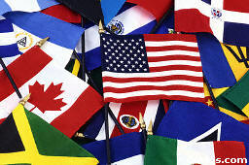
RELATED ISSUE 3
Social 20-1
Should internationalism be pursued?

Slide 2


The World is Shrinking…

Slide 3
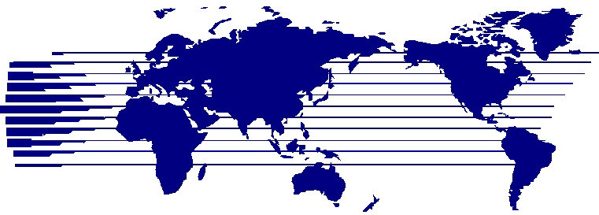
SHOULD INTERNATIONALISM BE PURSUED?

Slide 4
Motives of People/Maslow’s Hierarchy of Needs
People and nations are motivated in life by WANTS and NEEDS
NEEDS are basic to human survival
WANTS are things people desire, not necessarily needed for survival
Maslow says all humans are motivated to meet their survival needs
Structured this as a pyramid

Slide 5
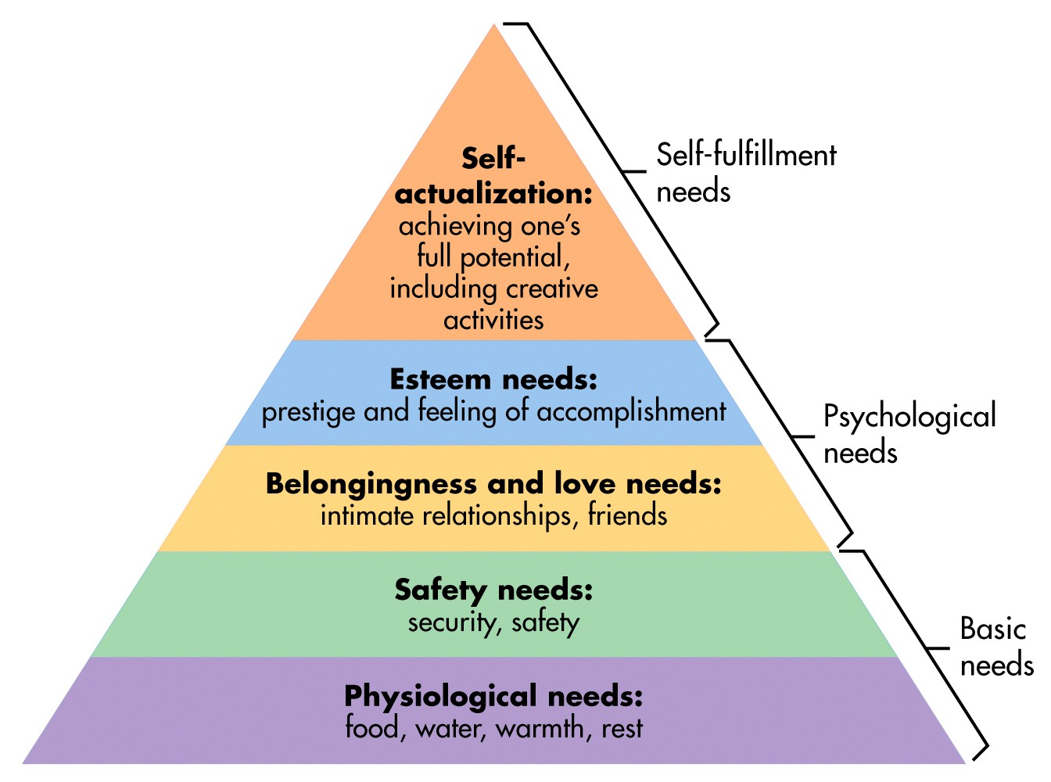
Maslow’s Hierarchy of Needs

Slide 6

Maslow’s Hierarchy of Needs
Maslow states that humans
will move up the pyramid as
their more basic needs get
met

Slide 7
What About Nations?
Nations and nation-states are made up of PEOPLE
Therefore, it is natural for nations to somewhat pursue things the same way that people do, along a hierarchy of needs
Successful nation-states, democratic ones especially look to satisfy the needs of their people

Slide 8
Economic Stability
Well being of nations people to support and take care of themselves
Employment
Nation-states attempt to provide
their economies with the best,
most qualified workforce
Nations take long-term and short-term plans to ensure economic stability

Slide 9
Peace and Security
Nation-states wish to provide their citizens with safety
  Go to work, school, have freedoms
Sense of national safety and security
  If the people are insecure, they are likely to oppose the government
  Security of the person
  Insecurity hurts the economy
Promotion of security
  International Organizations, NATO, UN etc.
  History of NATO
  Darfur in 10 min.

Slide 10
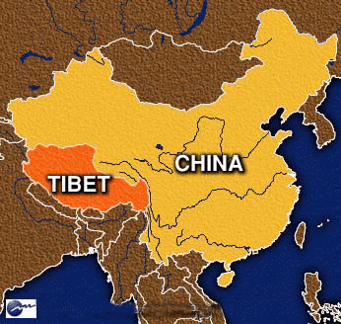
Self-Determination
Like people, nations and nation-states have a desire to be in control of their fate
Self-determination and Sovereignty
  Collapse of Soviet Union
Indigenous Peoples
  Self-Government
  Recognition within a larger nation-state

Slide 11
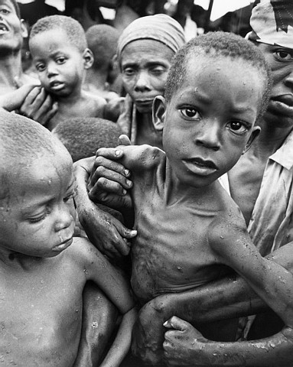
Humanitarianism
Actions to assist and relieve suffering and the innocent in the world
Natural Disasters
Disease
  WHO
  Right to Play 2
War/Conflict
Aid
  Money and Supplies
  Accepting Refugees
  UN MDG

Slide 12
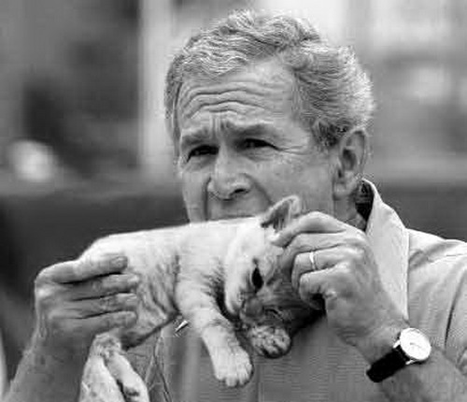
How Do Nation-States Respond to the World?
Isolationism
  Complete opting out of participation in international affairs
  Examples:
    Feudal Japan
    United States-interwar years, not joining L of N
    Switzerland- remaining neutral
Unilateralism
  Responding to events on their own
  The United States – the Bush doctrine
Notes:
Different pundits would attribute different meanings to "the Bush Doctrine", as it came to describe other elements, including the controversial policy of preventive war, which held that the United States should depose foreign regimes that represented a potential or perceived threat to the security of the United States, even if that threat was not immediate; a policy of spreading democracy around the world, especially in the Middle East, as a strategy for combating terrorism; and a willingness to unilaterally pursue U.S. military interests.^{[3][4][5]} Some of these policies were codified in a National Security Council text entitled the National Security Strategy of the United States published on September 20, 2002.^{[6]}
The phrase "Bush Doctrine" was rarely used by members of the Bush administration. The expression was used at least once, though, by Vice President Dick Cheney, in a June 2003 speech in which he said, "If there is anyone in the world today who doubts the seriousness of the Bush Doctrine, I would urge that person to consider the fate of the Taliban in Afghanistan, and of Saddam Hussein's regime in Iraq."^{[7]}

Slide 13



How Do Nation-States Respond to the World?
Bilateralism
  2 countries together, motivated by the same want or need
  Canada-US Air Quality Agreement
Multilateralism
  Several Countries working together on an issue
  Typically the approach of middle powers, increases their influence on issues when working in numbers
  UN, WTO
Supranationalism
  Agreeing to abide by the decisions of an international organization of independent officials
  European Union – the Euro

